Slide 1
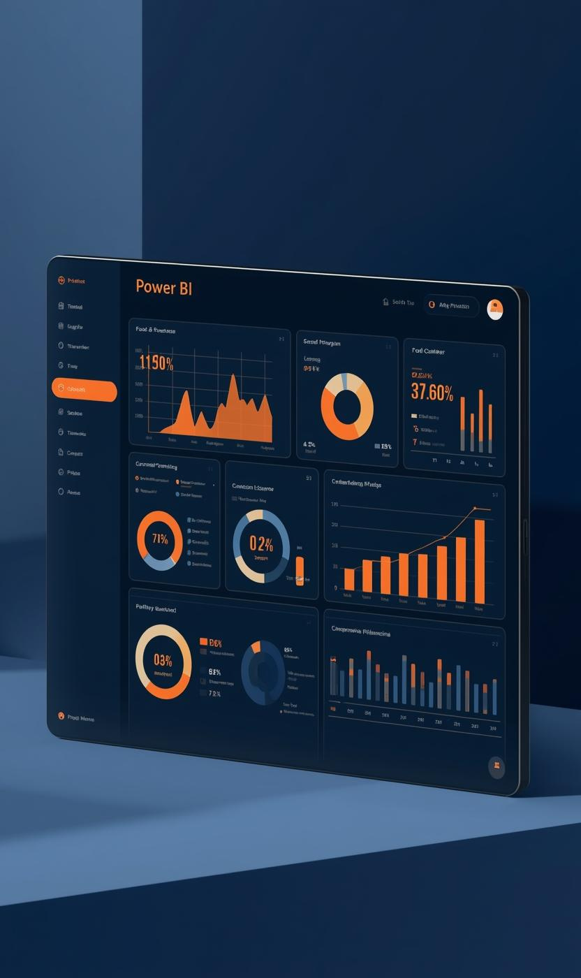

Food Trends: Understanding Customer Preferences in the Food Business

Slide 2

Introduction
“Data analytics plays an important role in helping businesses understand customer behavior and improve their strategies. In this project, we developed interactive dashboards to analyze customer engagement, product performance, and customer sentiment.
The Customer Segmentation Dashboard helps identify customer preferences, engagement levels, and product ratings across different food categories. It provides insights into how customers interact with different products.
The Business Strategy and Product Innovation Dashboard focuses on analyzing product performance, pricing strategies, and top-performing categories to support better business decisions.

Slide 3

Project Objectives
Key Goals for Data Analytics Insights
Engagement Patterns
Top Categories
Product Innovation
Understanding customer engagement patterns allows businesses to tailor offerings, enhancing satisfaction and loyalty through targeted marketing strategies based on real-time data analysis.
Identifying top-performing food categories enables informed decisions on product placement and promotional efforts, ultimately driving sales and maximizing customer reach within specific segments.
Supporting product innovation through data insights fosters creativity in developing new offerings and adapting existing ones to meet evolving customer preferences and market trends.

Slide 4
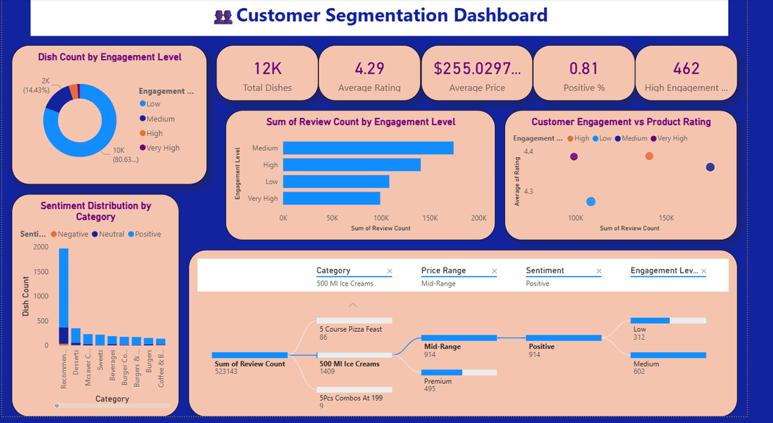
Customer Segmentation Dashboard Insights
Visual Representation of Customer Data
Dashboard Overview
Analyzes customer engagement, sentiment, and product ratings.
Helps identify popular dishes and customer preferences.
Supports data-driven business decisions.

Slide 5
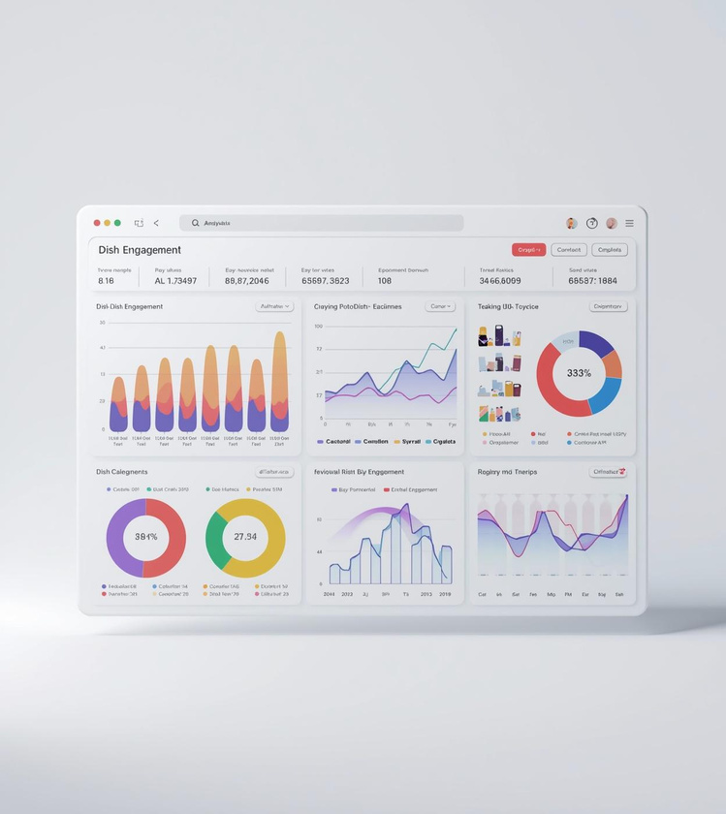

Engagement Analysis of Dishes
Engagement Analysis
Most dishes fall under low engagement.
Medium engagement dishes receive the highest reviews.
High engagement items represent the most popular dishes.
High Engagement
Low Engagement
Dishes showing high engagement receive excellent reviews.
Low engagement dishes need strategic improvements identified.

Slide 6

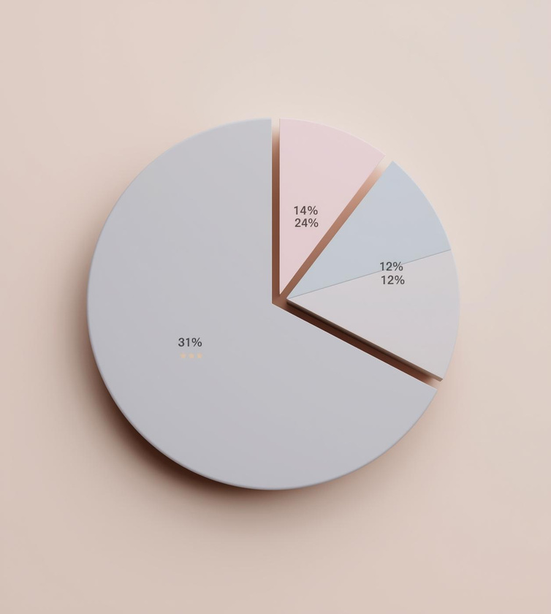
Customer Reviews & Ratings Insights
Customer Ratings
Engagement Levels
Ratings Distribution
Average ratings range between 4.3 – 4.4.
Ratings remain consistently high across engagement levels.
High engagement dishes often have better customer satisfaction.
Understanding customer engagement shapes product strategies effectively.
Analyzing ratings aids in refining product offerings regularly.

Slide 7
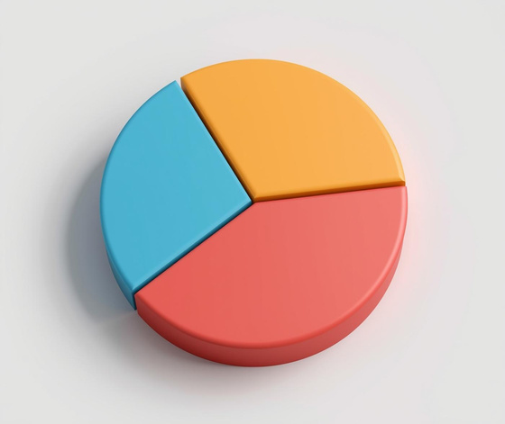


Key Insights
Key Insights
Mid-range priced items generate more engagement.
Most products receive positive customer feedback.
Popular categories include desserts and ice creams.

Slide 8
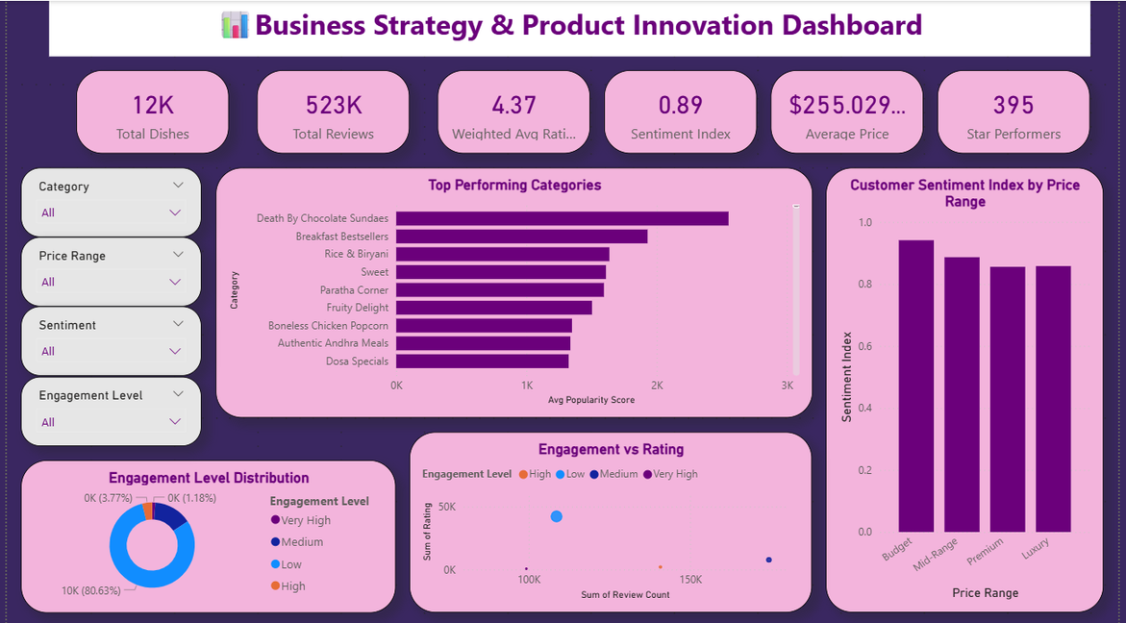
Business Strategy & Product Innovation Dashboard
Dashboard Overview
Provides insights into product performance, customer sentiment, and engagement levels.
Helps businesses identify top-performing categories and pricing strategies.
Supports data-driven product innovation and strategic decision-making.

Slide 9

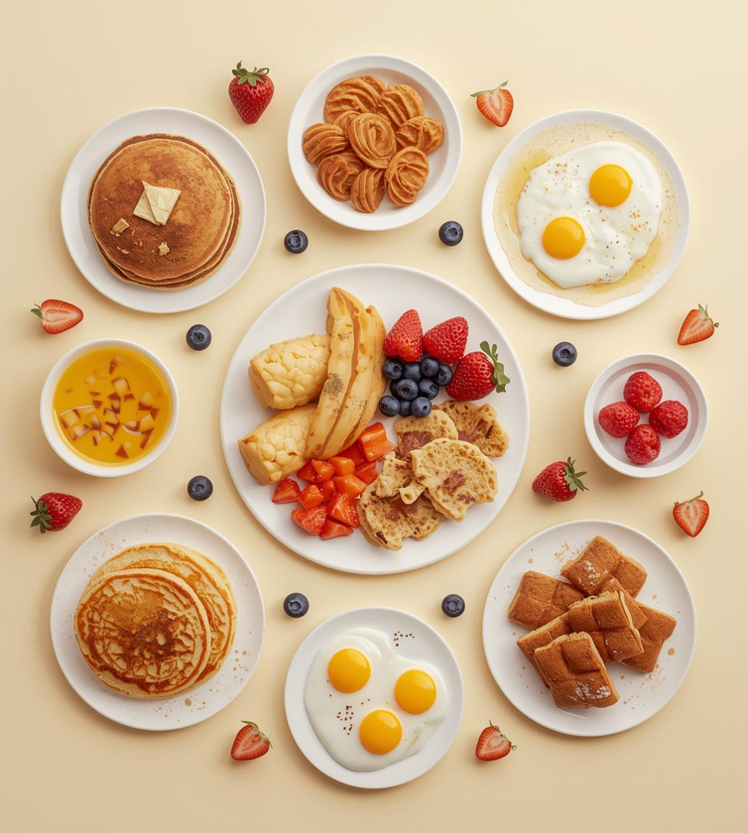
Top Performing Food Categories
Top Performing Categories
Popular categories include:
Death by Chocolate Sundaes
Breakfast Bestsellers
Rice & Biryani
Sweet dishes
Desserts and breakfast items show high popularity scores.
Desserts
Breakfast Bestsellers
High customer engagement with sweet offerings and treats.
Popular morning choices driving customer satisfaction and loyalty.

Slide 10


Pricing Strategy Insights and Implications
Customer Sentiment by Price Range
Budget Insights
Premium Appeal
Budget items have the highest sentiment score.
Mid-range products maintain strong customer satisfaction.
Premium and luxury items show slightly lower sentiment levels.
Customers prefer budget options with positive sentiment trends.
Premium offerings attract high ratings and positive sentiments.

Slide 11
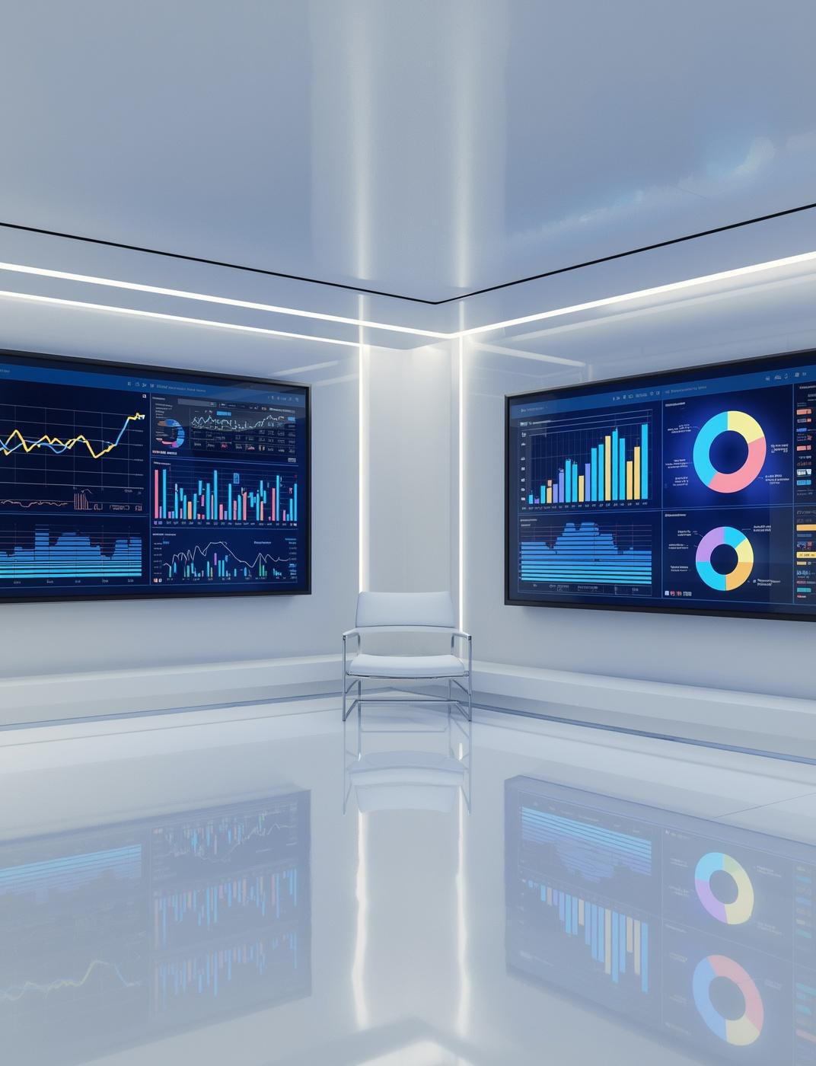
Engagement vs Rating
High engagement items receive more reviews and higher ratings.
Most products maintain ratings above 4.3.
Indicates strong customer satisfaction across categories.

Slide 12
Engagement Level Distribution
Majority of dishes fall under low engagement (around 80%).
Medium engagement contributes significantly to customer interactions.
High and very high engagement items represent top-performing dishes.

Slide 13
Key Insights
Desserts and breakfast categories drive strong performance.
Budget and mid-range pricing attracts higher positive sentiment.
Customer ratings remain consistently high across products.
A small group of dishes generate very high engagement.

Slide 14
Conclusion
The dashboards provide valuable insights into customer engagement, sentiment, and product performance.
Customer ratings remain consistently high, indicating strong satisfaction with the available products.
Desserts and breakfast items emerge as top-performing categories with high popularity.
Budget and mid-range priced products receive the most positive customer sentiment.
Most dishes fall under low to medium engagement, while a few items generate very high customer interaction.
Data-driven insights from these dashboards can help businesses improve product strategies, optimize pricing, and enhance customer experience.

Slide 15
THANK YOU!!!!!!

